Slide 1


Having a Heart for Physics
Experiments are for Everyone
April Meadows
Mentored by John Kistler
NAU NASA Space Grant

Slide 2
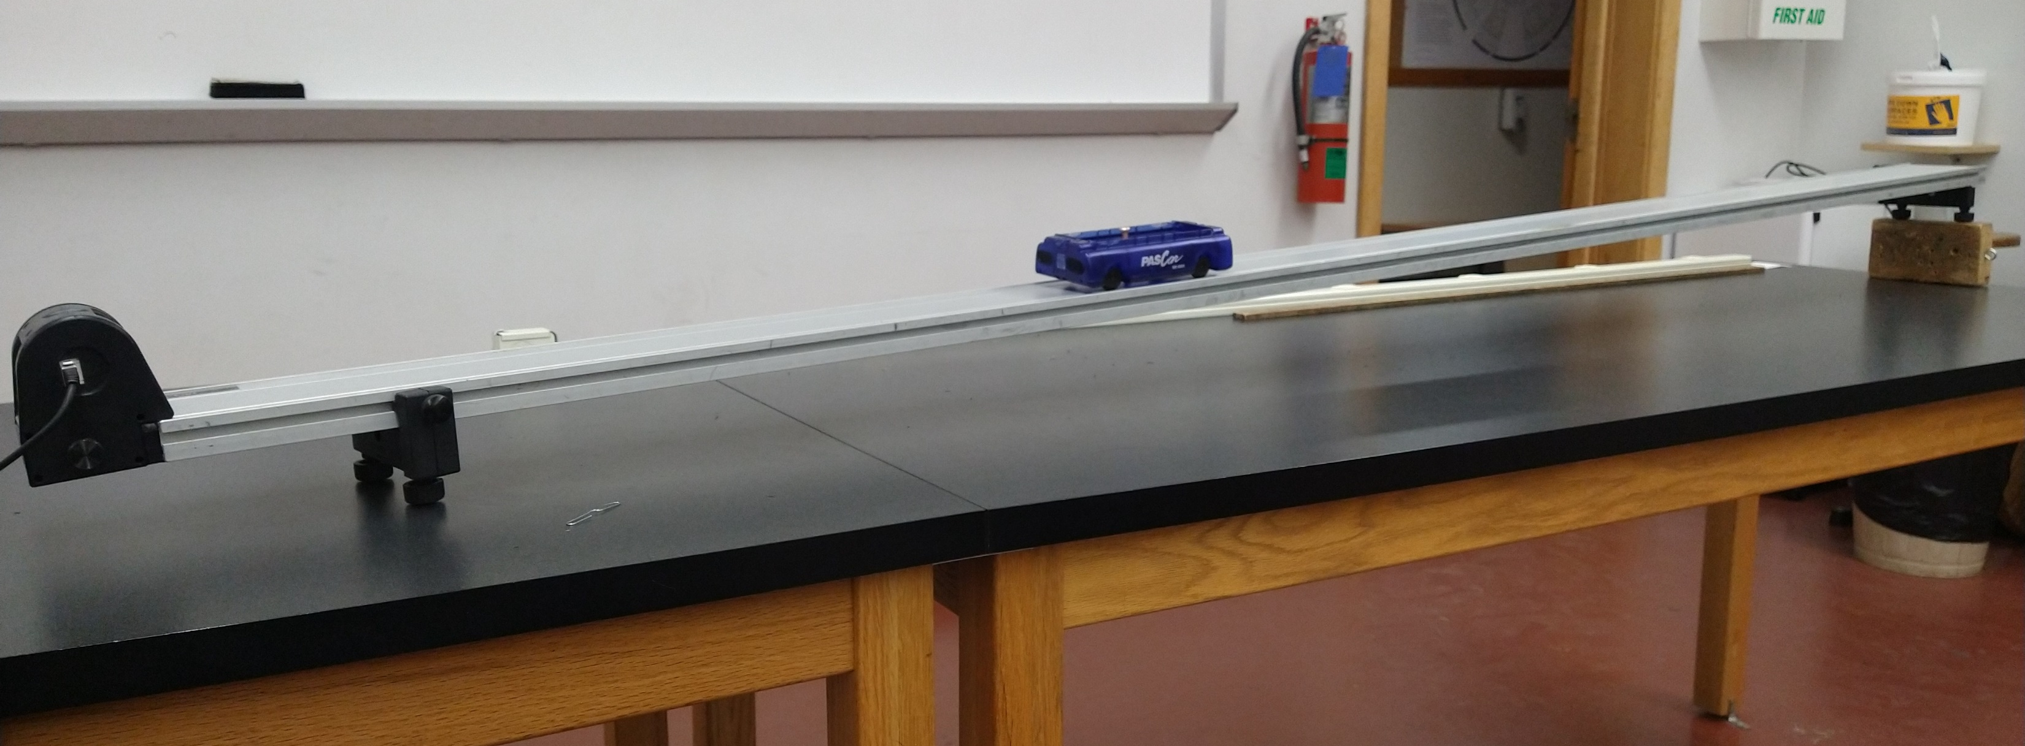
Purpose
Write a physics lab that appeals to non-physics majors, specifically Biology majors
Notes:
My job this year was to write a lab that appeals to non-physics majors
Biology students at NAU are required to take a physics lab for their degree
Traditional mechanics doesn’t have obvious applications to biology
The acceleration of a cart going down a ramp
What does that have to do with biology?
- Can be difficult for them to be interested
In order to do this, I served as the Lab Assistant for the first year physics labs>

Slide 3
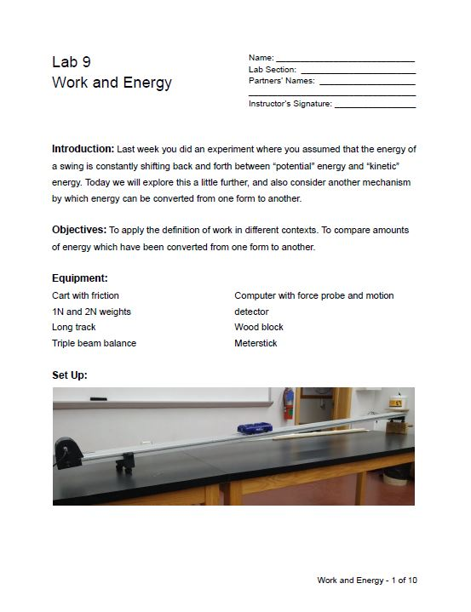
Preparation
Lab Assistant:
Build weekly labs for first year physics students
Rewrite and digitize current labs
Notes:
As lab assistant I did the following things
I built 12 sets of 3 different labs each week – PHY 111, PHY 161, PHY 112/262
I am rewriting the current lab manuals we have
They need clearer instructions and pictures – interpreting them was difficult
Include example with picture of set up
Putting the labs into a digital format
Easily accessible
Labs available online
What could cause that?
Doing all this allowed me to *make*an additional lab

Slide 4
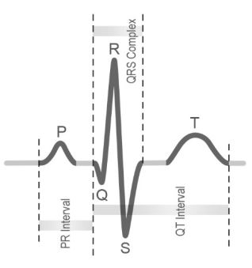
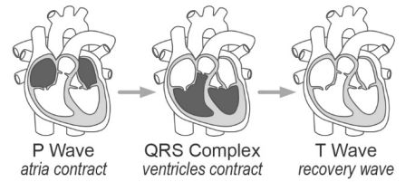
Project Goal
Voltage (microvolts)
Adapt EKG labs from PASCO
EKG or ECG stands for electrocardiogram
An electrocardiogram measures the electrical signal of the heart over time.
Time (seconds)
PASCO Labs – Factors that Affect the Heart
Notes:
The lab was a set of EKG labs originally written by PASCO
Adapting an EKG lab from PASCO labs
EKG, also known as ECG, stands for electrocardiogram
An electrocardiogram measures the electrical signal of the heart
We can determine if a heart isn’t working properly from the signals
Explain layout of the graph:
P wave
R wave
Q wave
S wave
T wave
PR Interval
QRS Complex
QT Interval
Ultimately the lab became a 3 part lab showing different aspects of the EKG

Slide 5
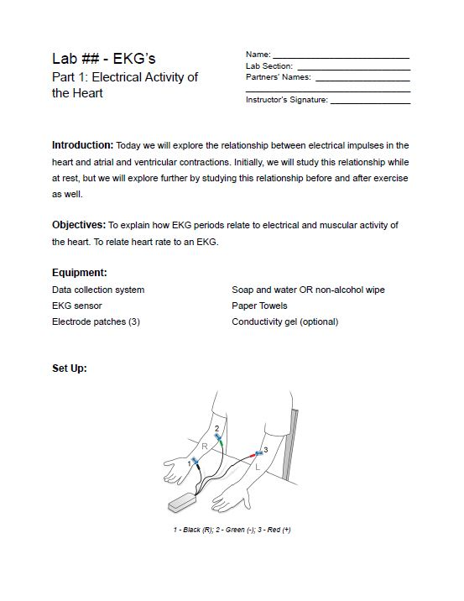
Project Result
Three EKG labs from PASCO’s lab archive were selected and put together into one lab with three part:
Electrical Activity of the Heart
Factors That Affect the Heart
Heart Rate Recovery
Notes:
3 sections are:
Electrical Waves of the Heart
Factors that affect the Heart
Heart Rate Recovery
Questions students will answer:
What does an EKG show about heart activity?
How does the heart respond to exercise?
How does heart activity before exercise compare to after exercise?
- other questions

Slide 6
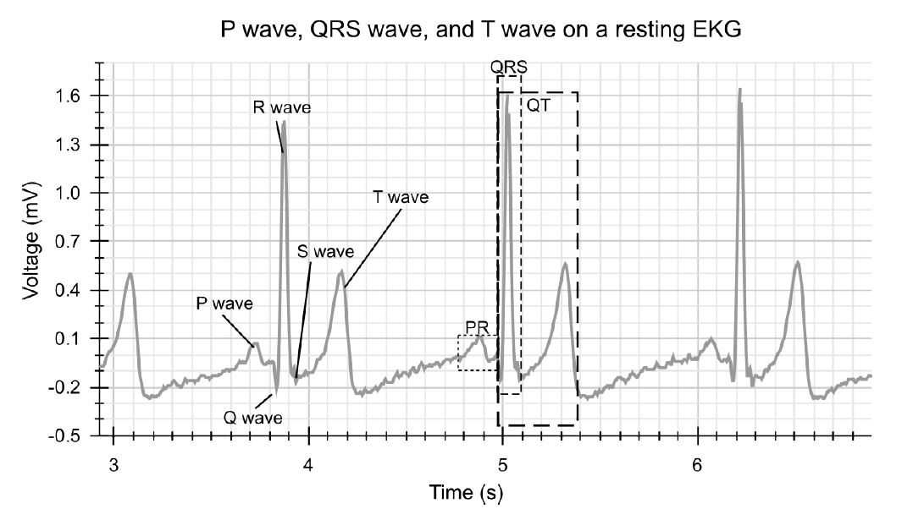
Electrical Activity of the Heart
Objectives:
Learn what an EKG is
Learn an EKG’s purpose
Practice taking timed measurements
Plot a variable against time
PASCO Labs – Electrical Waves of the Heart
Notes:
The first section of the lab is called Electrical Waves of the Heart
Objectives:
Students will learn what an EKG is
What its purpose is
Get hooked up to mini EKG
Plot signal vs time

Slide 7
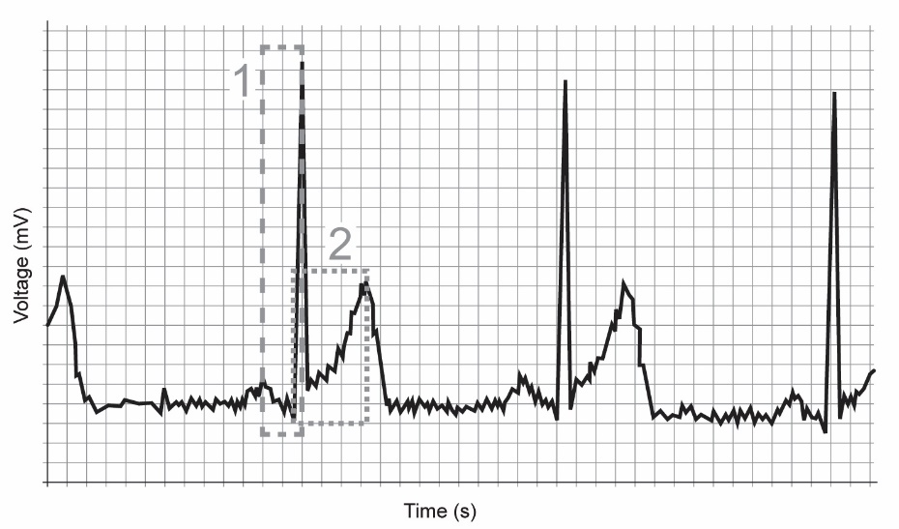
Factors That Affect the Heart
Objectives
Expand upon previous section using collected data
Measure and record electrical activity again after 30 seconds of exercise
Compare data from first trial and note differences
PASCO Labs – Factors That Affect the Heart
Notes:
The second section is Factors that affect the Heart
Expansion of previous section
Use results from first section
Jumping jacks/jog for 30 sec
Measure and plot electrical signal vs time again
Compare graphs from rest to exercise
Picture shows example of what student would see
- Note differences between this and last picture

Slide 8
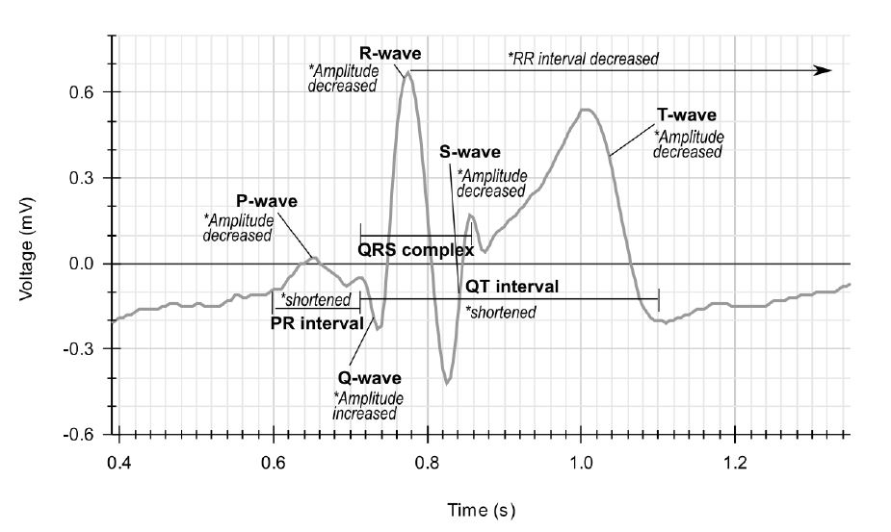
Heart Rate Recovery
Objectives
Expand upon previous two sections using collected data
Measure and record electrical activity again after a certain period of rest after exercise
Compare data from previous few trials and note differences
PASCO Labs – Heart Rate Recovery
Notes:
The third section, Heart Rate Recovery:
Expansion of previous two sections
Use results from earlier
Measure and plot electrical signal vs time after resting period
Can see how long it takes to return to original resting results
Picture shows example of what a student would see
Highlights differences between
The equipment we will be using is as follows

Slide 9
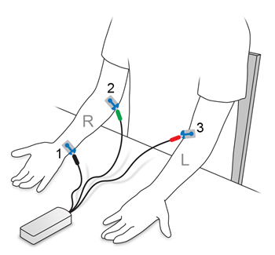
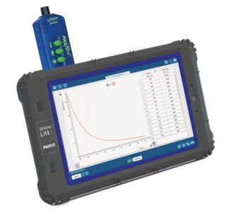
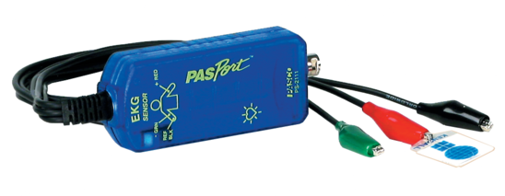
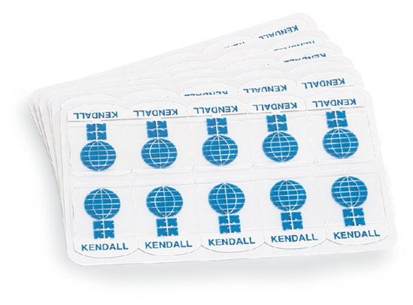
Equipment and Set Up
PASCO Labs – PASport EKG Sensor
PASCO Labs – Spark LXi2 Datalogger
PASCO labs – EKG Sensor Patches
PASCO Labs – EKG setup
Notes:
This equipment will be used for this lab:
PASCO SPARK LXi2 Datalogger
This is where the data will be loaded
PASCO PASport EKG Sensor
This detects the EKG signals
Black, green, red sensors
PASCO EKG Sensor Electrode Patches
Picks up electrical sensors from the body
The picture on the right shows how the equipment is set up
This lab will accomplish a few objectives

Slide 10
Intended and Future Use
Primary focus is learning to measure a variable against time and to interpret graphs
Ideally the lab will be expanded:
Electromagnetism
Mechanical Pumps
Fluid Dynamics
Notes:
These objectives are:
- Measure a variable against time
Draw a graph from data
Interpret graph results
This lab can be expanded:
Electromagnetism:
Electrical function of the heart
Mechanical Pumps
Heart is a pump
Fluid Dynamics
Blood is a fluid
This lab will hopefully have a few outcomes

Slide 11
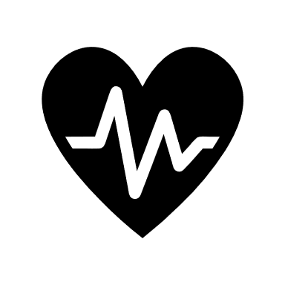
Impact
Inspire students to:
Be health focused
Have an interest in physics
Notes:
Ideally this lab will:
Help students focus on their health
Learn what EKG is and how it works
Learn how to maintain heart health
Learn impacts of not maintaining heart health
Help non-physics students develop an interest in physics
See how physics applies to everyday life
Learn skills from physics to improve their own skills
I hope this inspired you in some way

Slide 12
Thank you for listening! Any questions?

